Slide 1
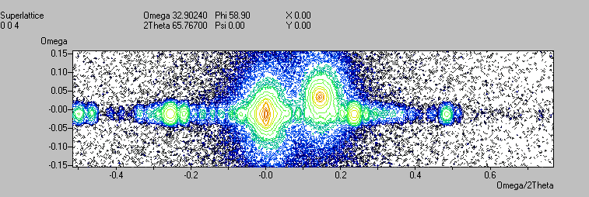

X’Pert Epitaxy Software
Version 3.0
Notes:
X’Pert Epitaxy 3.0 is an analytical software package to analyze rocking curves, diffraction maps and wafer maps
It is intended for use with
X’Pert PRO MRD and earlier high-resolution diffractometers
X’Pert PRO diffractometers for analysis of sample perfection
Double crystal diffractometers
This presentation will give an overview of the use and the functionality of X’Pert Epitaxy 3.0.

Slide 2
X’pert Epitaxy Functionality
Graphics for single scans, area scans and wafer maps
Peak finding and labelling for single and area scans
Results from rocking curves and maps
Rocking curve simulation
Orientation and unit cell calculations
Notes:
X’Pert Epitaxy main functionality comprises:
Graphics for single scans, area scans and wafer maps
X’Pert Epitaxy provides graphics for single scans, area (2-axes) scans and wafer maps
Peak finding and labelling for single and area scans
Substrate, layer and fringe peaks are automatically searched and labelled
Results from rocking curves and maps
A large number of results can be derived from peak positions
From rocking curves: d-spacings, layer thicknesses, composition and mismatch, superlattice period and mean mismatch
From two rocking curves: sample curvature
From area scans: parallel and perpendicular mismatch and the layer tilt angle
From a set of reflections: orientation matrix
Rocking curve simulation
Rocking curves can be simulated according to Takagi Taupin equation of dynamic X-ray theory
Orientation and unit cell calculations
Orientation matrix refinement enables the calculation of the sample normal direction (orientation refinement) or the sample unit cell parameters (unit cell refinement) from the measured positions of Bragg reflections.

Slide 3
New Features in Version 3
Simulation of hexagonal nitride alloy layers with choice of substrate
Modelling of relaxed interfaces and diffuse scattering
Plotting up to six area scans in one window
Extraction of line scans at any angle
Smoothing of single scans
Summary results for rocking curves
released
November
1999
Notes:
New features introduced in X’Pert Epitaxy version 3.0 are:
Simulation of hexagonal nitride alloy layers with a choice of substrates
Rocking curves for nitride alloys with a wurtzite structure on nitride, sapphire or silicon carbide substrates can be simulated
Modelling of relaxed interfaces and diffuse scattering
Relaxed interfaces in cubic semiconductors and diffuse scattering can be simulated in rocking curves
Plotting up to six area scans in one window
Extraction of line scans at any angle
Line scans can be extracted from area maps, not only parallel to the axes, but at any angle
Smoothing of single scans
Summary results for rocking curves
This option is used to display layer mismatch, composition and thickness in a single results pane for a rocking curve. The results pane and the rocking curve can be printed on a single sheet of paper.

Slide 4
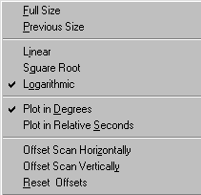
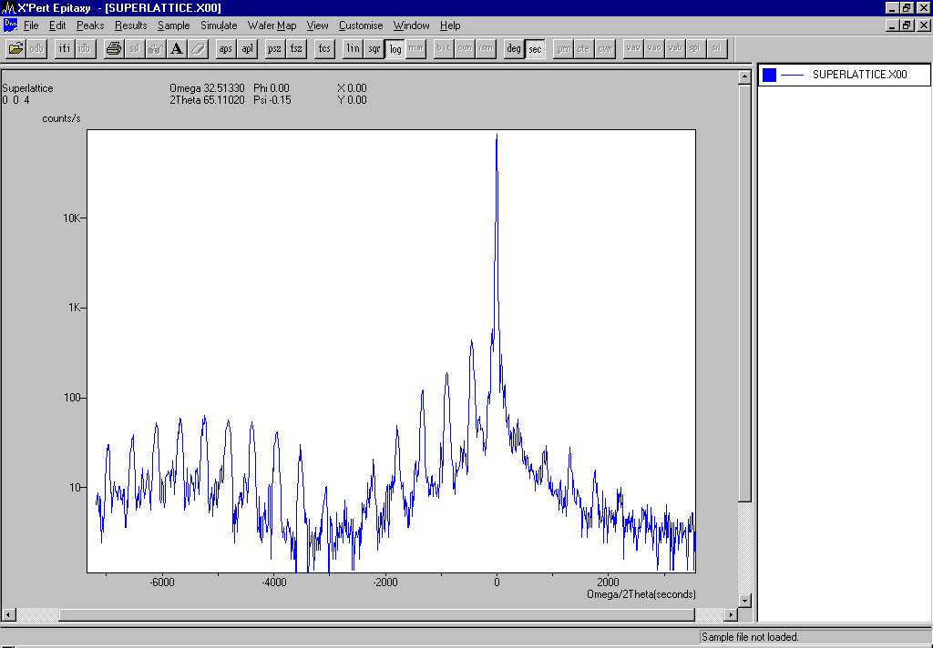
Plotting Single Scans
Load from X’pert database or from file
Linear/square root/log
Degrees /relative seconds
Zooming
Notes:
Rocking curves can be loaded either from file or from the X’Pert database
Plotting options for rocking curves comprise:
Selection of the vertical scale in linear, square root or logarithmic
Selection of the horizontal scale in (absolute) degrees or (relative) seconds
Zooming
Horizontal and vertical offsetting

Slide 5
Editing options
Removing or adding scans to current window
Editing header
Adding text
Smoothing
blue - experimental curve
red - all values below 100cps
smoothed
Notes:
Rocking curves plots can be edited:
Scans can be removed from or added to the window
The header of the plot can be changed
Text can be added to the plot
A smoothing method is employed which is appropriate for reducing statistical noise in data
These options can be entered via the Edit menu

Slide 6
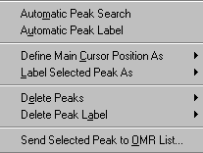
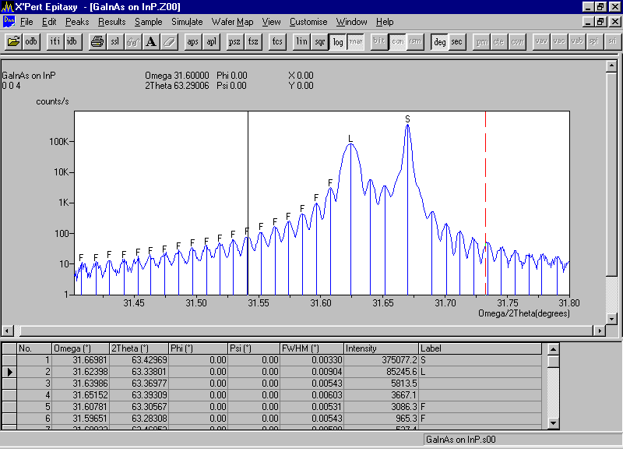
Finding and labelling peaks
Peak position marked automatically or using cursor
Substrate, Layer and Fringe labels used by Results menu
Peak list display
Notes:
Peaks can be found automatically for single scans, and semi-automatically for area scans.
Peak positions can be chosen using the cursor for all scans. There are two cursors - a main cursor and a reference cursor. The cursor and the cursor status bar are accessed using the View menu.
The marked peaks can be sent to the Orientation Matrix Refinement list.
Labeling can be done automatically or manually.
The peak labels are used by the calculation of results (d-spacing, layer composition, layer orientation and thickness, superlattice period etc.).
The peak list is displayed in a separate window

Slide 7
Defaults for single scans
Folders
Single plot options
Palettes
Use relative seconds
Peak finding
Wafer map settings
Notes:
Application Defaults can be set via the Customize - Defaults menus.
The Defaults dialogue has tabbed sections to allow you to set up default values for:
Folder names for stored and calculated data
Intensity levels for area scans
Ewald sphere radius when plotting area maps and Q scans
Substrate and layer materials for sample files
Peak search and labelling for single scan files
Peak search and labelling for wafer mapping
Simulation and convolution parameters
Extracting and projecting scan

Slide 8
Sample Files
Sample files contain information about heteroepitaxial layer structures
Rocking curves are simulated using the information in the sample file
The information is also used by the Results menu
Notes:
Sample files can be created to store information about the layer structure of an epitaxial sample. Samples consist of a substrate plus any layers which have been deposited on it. The sample file contains the following information:
For the substrate:
substrate material, orientation and thickness
offset angle
For each layer:
layer material, orientation, thickness and composition
grading (composition variation with depth)
percentage relaxation relative to layer beneath
Two types of layer are defined:
Graded: Layer with composition changing with depth in the layer
Superlattice: Two or more layers which are repeated two or more times
Information from the Sample file is used for Rocking Curve Simulation and calculation

Slide 9
Sample Files : Materials Supported
Materials supported:
Diamond: e.g. Si, Ge
Zinc blende: e.g. GaAs, InP, AlSb
Hexagonal nitrides: AlN, GaN and InN
Sapphire and silicon carbide substrates

Slide 10
Layers and Substrates (1)
Single layers with or without composition grading
  grading options: none, linear, convex or concave
Superlattices, and superlattices within superlattices
In-plane rotation for nitrides on sapphire
Relaxed interfaces
Notes:
Single layers in sample files can be edited with composition changing with depth in the layer. The lattice parameter of the layer steadily increases or steadily decreases. The variation can be either none, linear, convex or concave. None is used for layers of constant composition.
Superlattices consist of two or more layers which are repeated two or more times. Any layer can form part of a superlattice. Thus sample files can be created for superlattices within superlattices and for superlattices including graded layers.
The relative in-plane orientation of nitride alloys on sapphire basal plane substrates can be user-adjustable rotated.
A relaxation parameter is used to model the change in unit cell distortion that occurs in imperfect interfaces where mismatch dislocations are present. This parameter is used to calculate the correct peak positions in simulated rocking curves.

Slide 11
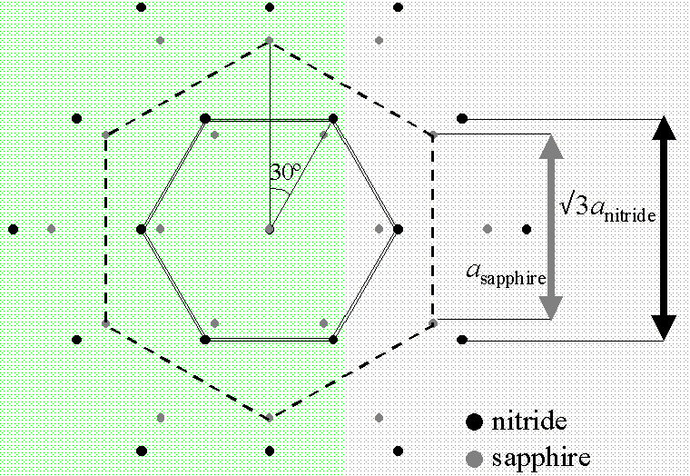
Layers and Substrates (2)

Slide 12
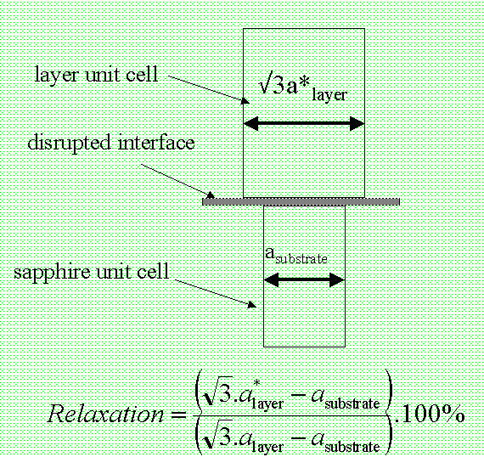
Layers and Substrates (3)

Slide 13
Versatile sample editing
Tree view of
current sample
T1 - GaN layers
linked by thickness
B1 - alloy layers
linked by thickness
and composition
Add, delete
and link
layers
Edit the
highlighted
layer
Save and
exit
Notes:
The layer structure in sample files can be edited using the dialogue with an expandable tree structure. You can model layers with grading (changing composition with depth), superlattices and superlattices within superlattices.
Layers can be linked by thickness and by composition.

Slide 14
Rocking curve simulation
Based on the work of Professor Paul Fewster
Uses Takagi-Taupin equations for diffraction by distorted crystals
Full data base of materials parameters and X-ray scattering factors supplied
Convolution functions for high resolution monochromators and double crystal diffractometers
Note: Simulation is not available in X’Pert Epitaxy Graphics
Notes:
The simulation procedure is based on the work of Prof. Paul Fewster at Philips Research Laboratories, Redhill, United Kingdom.
It uses the Takagi-Taupin equations of dynamic X-ray theory for diffraction by distorted crystals.
The materials database contains values for unit cell parameters for all the common cubic semiconductor materials, nitrides, silicon carbide and sapphire. X-ray scattering and absorption parameters for the elements from the International Tables for Crystallography are also included.
Instrumental effects for Philips high-resolution monochromators or Philips double crystal diffractometers can be added plus diffuse scattering, statistical noise and peak broadening due to curvature.

Slide 15

Convolution
(Adding instrumental/sample effects)
Monochromator type
Background
Counting statistics
Sample curvature
Diffuse scattering
Convolution can be performed as part of the
simulation process or applied after simulating
the diffracted intensity
Notes:
Rocking curves from lightly distorted heteroepitaxial structures can be simulated using Takagi-Taupin theory. X’Pert Epitaxy uses this theory to calculate the intensity diffracted by strained heteroepitaxial structures of cubic semiconductors. The Takagi Taupin equation is a differential equation for the rate of change of the diffracted amplitude with depth in a sample in terms of the diffraction geometry and the scattering factors of the reflection.
The first stage of the calculation is to calculate the intensity for a non-divergent monochromatic incident beam. The resulting intensity profile must be convoluted with a function representing the divergence and wavelength spread of the monochromator to produce a match to the experimental conditions. If the sample is curved a further convolution can be made to account for the range of angle of incidence across the width of the sample.
You can scale the intensity curves to match experimental curves by defining background intensities. It is also possible to add the effect of counting statistics and diffuse scattering to the calculated curve.

Slide 16
Simulating rocking curves
Optional mismatch plot
Range and step size in degrees or seconds
Rocking curves with and
without convolution
Notes:
Rocking curve simulation is started by setting the simulation data in the Simulation setup window.
Convolution can be added optionally.

Slide 17
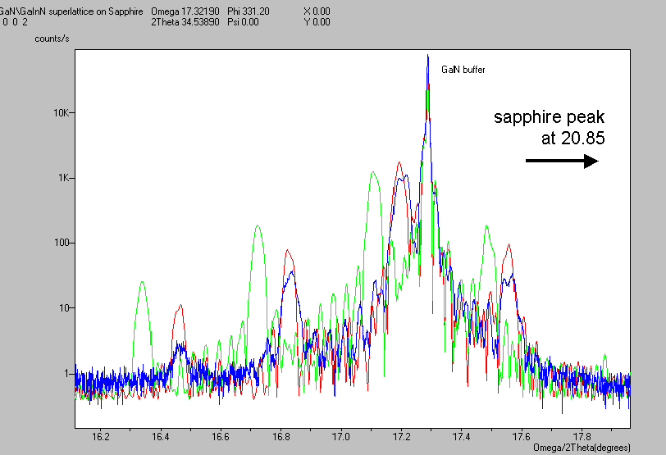
GaN on Sapphire
Experiment
First simulation
Second simulation
10 well nitride device on sapphire
Notes:
As an example a rocking curve simulation of a 10 well GaN device on sapphire is shown. The sapphire peak is at 20.85 degrees 2Theta (outside the simulation window).
Simulation is widely used to check the detailed structure of heteroepitaxial structures.
Simulation plays a key role in confirming the layer parameters of heteroepitaxial structures after a rocking curve has been recorded. It is also a valuable tool for planning growth experiments and planning X-ray measurements.
Making simulations before starting measurements can provide information to minimise the time required to collect useful data.
Simulation can be used to find:
which optics are needed to give sufficient angular resolution or dynamic range to see the features of interest
what is the maximum angular range over which significant diffracted intensity will be observed.

Slide 18
Defaults for simulations
Default substrate and layer combinations for all six substrate types
Default simulation and convolution settings
Automatic saving
Notes:
Defaults for simulation and convolution and for sample data can be set via the Customize - Defaults menu.

Slide 19
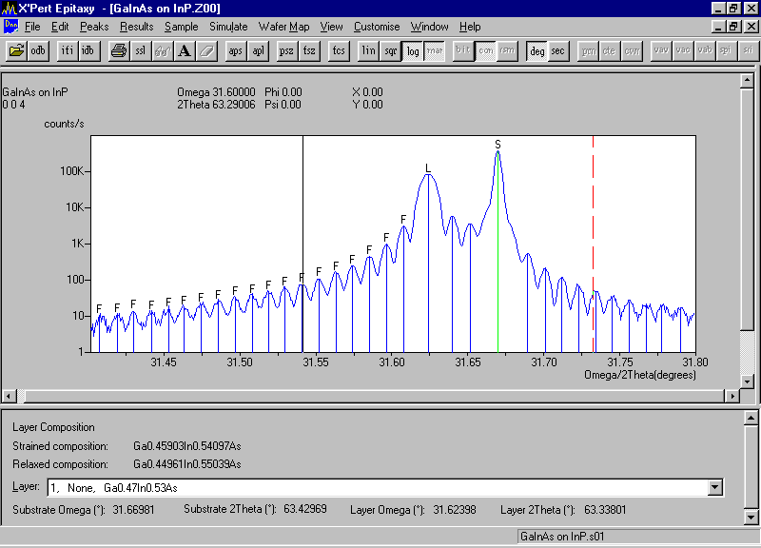
Results from Rocking Curves
d-spacing mismatch
Results summary
Layer mismatch
Layer composition
Layer thickness
Superlattice period
Sample curvature
Notes:
After labeling of the peaks in the rocking curve with
S - main reflection of substrate
L - main reflection of epitaxial layer
F - fringe peak
A large number of results can be derived from single rocking curves:
d-spacing mismatch, calculated from the separation of the substrate and layer peaks
layer mismatch, calculated from the separation of the substrate and layer peaks and the sample information for the situation that the layer is (a) fully relaxed and (b) fully strained
layer composition, calculated from the separation of the substrate and layer peaks and the sample information for the situation that the layer is (a) fully relaxed and (b) fully strained
layer thickness, calculated from the separation of two superlattice satellite reflections
superlattice mean mismatch, calculated from the separation between the zero order (or main) reflection close to the substrate reflection
sample curvature, calculated from the difference in the measured Bragg angles of the substrate peaks in two different scans on the same sample.
The results can be shown in the Results Summary window.

Slide 20
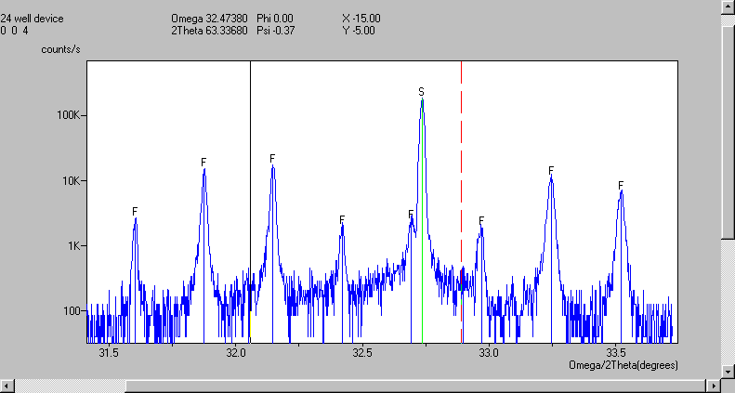
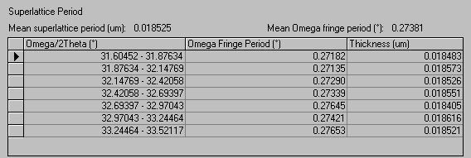
Superlattice Period
Fringe spacing and period averaged over all marked satellites
Notes:
The superlattice period is calculated from the mean separation of the marked satellite reflections from the superlattice diffraction pattern.

Slide 21
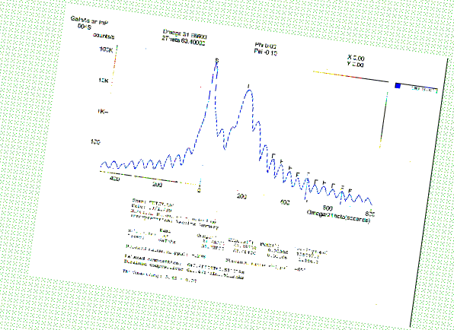
Results Summary for Rocking Curves
Composition, mismatch and layer thickness calculated together
Edit substrate and layer materials directly or use sample file
Print out on a single sheet:
Box for editing substrate
and layer materials
Notes:
The layer composition, layer mismatch and layer thickness are calculated together and shown in the Results Summary window.
Substrate and layer parameters can be edited directly or read from a sample file
A Print function is available to print all data together with the rocking curve on a single sheet.

Slide 22
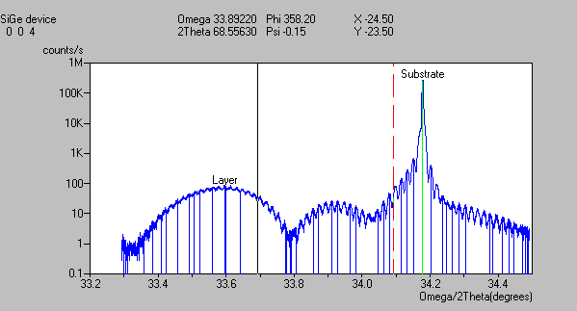
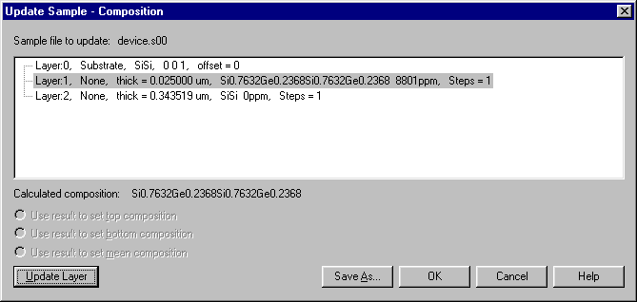
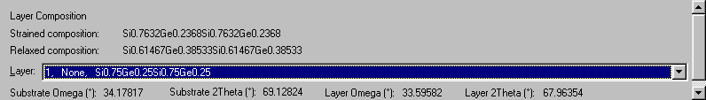
Updating sample files
Results used to update sample
Calculated results
Notes:
Results obtained from layer mismatch, composition and thickness calculations and from superlattice mean mismatch and superlattice period calculations can be used to update a sample structure file. This data can then directly be used for rocking curve simulations.

Slide 23
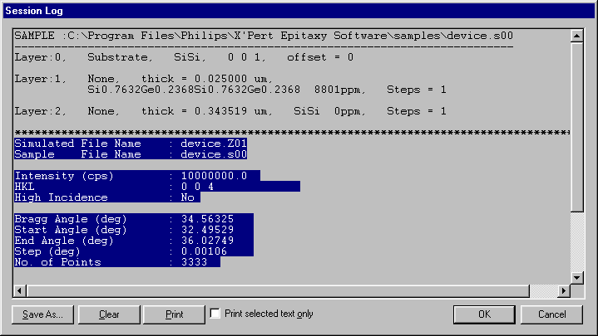
The Log
Send results to log
Send sample details to log
Send simulation details to log
Print out from log
Save as text file from log
Notes:
X’Pert Epitaxy has a Session Log which can be used to print out reports of calculations made using the Results menu.
When a calculation has been made in a results pane the menu item Results - Save Data to Session Log can be used to write the results to the log. Information can also be sent to the log from the Sample Data dialogue, the OMR and Unit Cells dialogue and the Simulation Setup dialogue.
The Session Log can also be printed or saved as a text file.

Slide 24
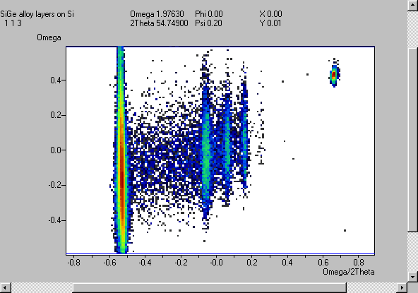
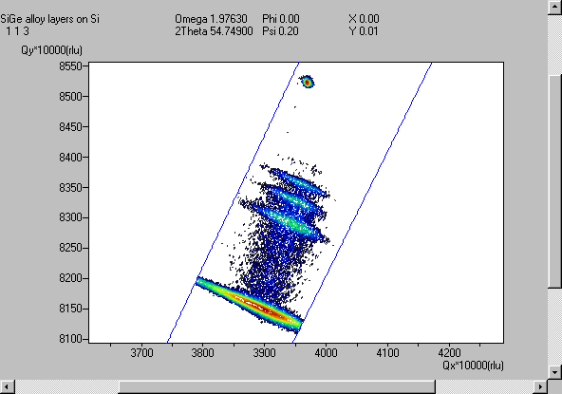
Plotting area scans
Load from X’Pert database or from file
Up to six scans per window
Linear/square root/log intensity scaling
Angle scales or reciprocal lattice units
Zooming
Semi-automatic peak find
Bitmap
(angles)
Contours (reciprocal lattice units)
Notes:
Area scans can be loaded either from file or from the X’Pert database.
Up to 6 scans can be loaded simultaneously.
Plotting options for area scans comprise:
Selection of the vertical scale in linear, square root or logarithmic
Selection of the horizontal scale in degrees (Omega, 2Theta) or reciprocal lattice units
Zooming
Drawing bitmaps or contour plots
Semi Automatic Peak Search can be used to determine the maximum intensity and full width at half maximum along the two axial directions for a peak in an area scan. Select a rectangle around the peak for which wish to determine the peak data.

Slide 25
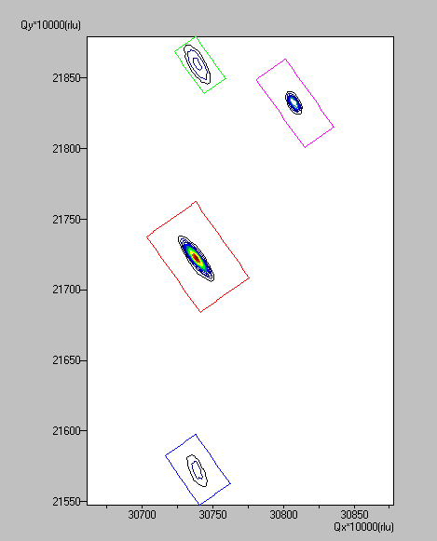
Multiple area maps
new plotting
functionality
Plot up to 6 maps in a window
Use :
  when you do not want to collect data between peaks
  when you have not collected a large enough area on the first attempt
  to plot scans collected with different optics together
Notes:
Up to 6 area maps can be plotted in one window. This option is useful:
when you do not want to collect data between peaks
when you have not collected a large enough area on the first attempt
to plot scans collected with different optics together

Slide 26
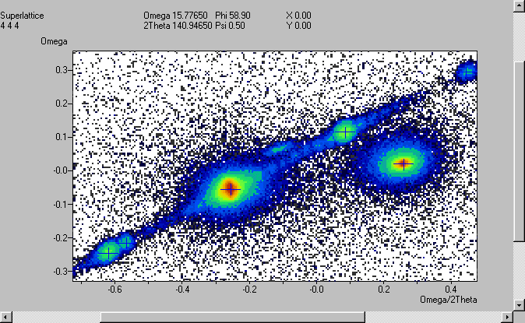
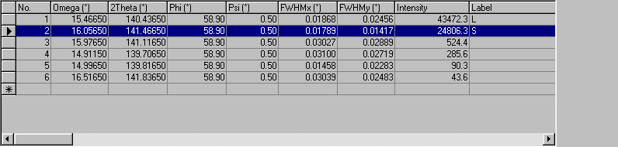
Peak Find
Use semi automatic peak find
Label peaks to be analysed
Notes:
In area maps a semi-automatic option to find peaks is present.
Use the pointer to define a rectangle around the peak for which you wish to find the centroid. Vertical and horizontal lines of data points are then added up and the centroid is detected.
The found peaks can then be labeled as substrate, layer or fringe peak.

Slide 27
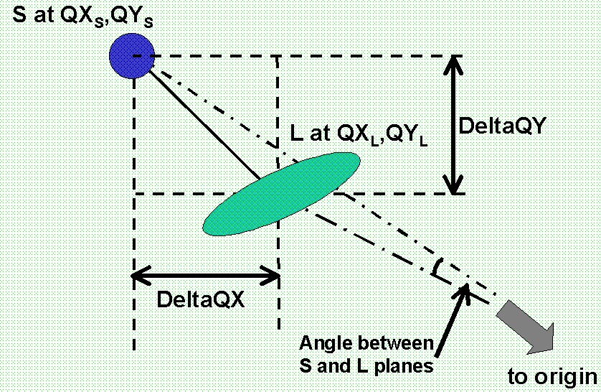
Parallel & Perpendicular Mismatch
Mark substrate and layer peaks
Determine mismatch in two directions from a single asymmetrical map
Determine tilt between substrate and layer planes
In reciprocal space
Notes:
From an area scan of an asymmetric reflection the perpendicular and parallel mismatch and the angle between the substrate planes can be found.
Mark the substrate and layer peaks found with semi-automatic peak search
Use the Results - Parallel and Perpendicular Mismatch menu to calculate the required data.

Slide 28
Parallel & Perpendicular Mismatch
Angle plot
Example
Relaxed GaInAs on GaAs
Notes:
An example is shown for a relaxed InGaAs layer on GaAs.

Slide 29
Editing options
Removing or adding scans to current window
Extracting single scans
Extracting area scans
Projecting onto axis
Editing header
Adding text
Notes:
Area map plots can be edited in the following ways:
Area scans can be removed from or added to the window
Single scans can be extracted from an area scans
Area scans can be extracted and saved as an area scan by selecting a rectangular area in an area map plotted in degrees
Area scans plotted in degrees can be projected onto either of the axes to create a single scan
The header of the plot can be changed
Text can be added to the plot
These options can be entered via the Edit menu

Slide 30
Using the Extraction Line
Extract lines scans at any angle from maps
Extract Q scans from reciprocal space maps
extraction
line
pull on handles
to change angle
and length
extraction
angle
Notes:
Line scans can be extracted from area maps, not only parallel to the axes, but at any angle.
The start and end point of the line are set with the main and reference cursors.
The line scan can then be saved as single scan.
Scans with 2Theta as second axis can be projected horizontally to produce rocking curves which can be compared with simulated data. The projected scan is equivalent to a rocking curve recorded with a wide open detector.

Slide 31
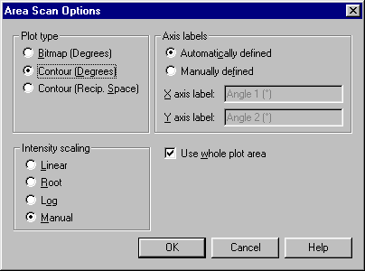
Defaults for area plots
Area plot options
Scan treatment options
Folders
Manual levels
rlu values
Palettes
Notes:
Area scan Defaults can be set via the Customize - Area scan options menu.
Scan Treatment Options can be set via the Customize - Defaults menu.
Other customizable options comprise:
Selection of Default Folders
Manual plot levels
rlu values
Color Palettes for bitmaps or contour plots

Slide 32
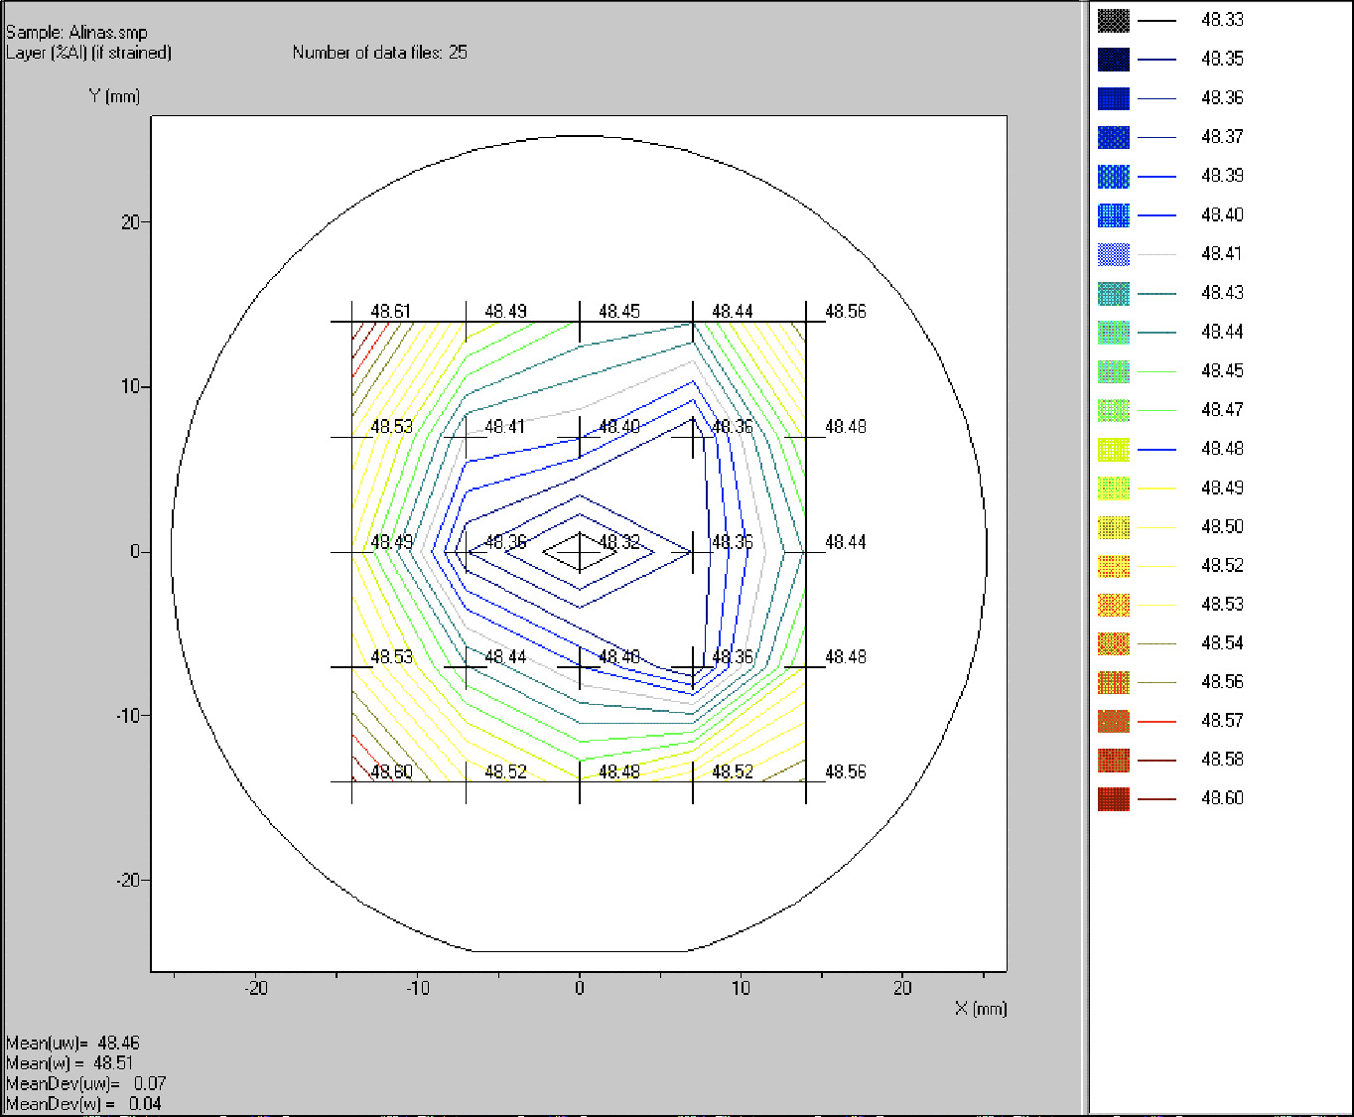
Wafer Maps
Peak parameters and results from a regular array of rocking curves
View contours, values or both
Linear or manual contour levels
Editable outline shape for wafer
Notes:
Wafer maps are used to demonstrate the uniformity of substrate wafers and of the heteroepitaxial layers grown on them.
Contour maps showing variations across a wafer can be created from a set of rocking curves recorded using a rectangular grid of points on the sample.
Peak parameters and derived parameters such as the lattice parameter mismatch, or the period of a superlattice can be mapped.
Wafer map data can also be displayed as numerical values at each measurement position.
The contour levels can be set on a linear or a manual scale.
The data can be plotted with a superimposed wafer outline.
Tables of peak positions and derived results are stored in ASCII files.

Slide 33
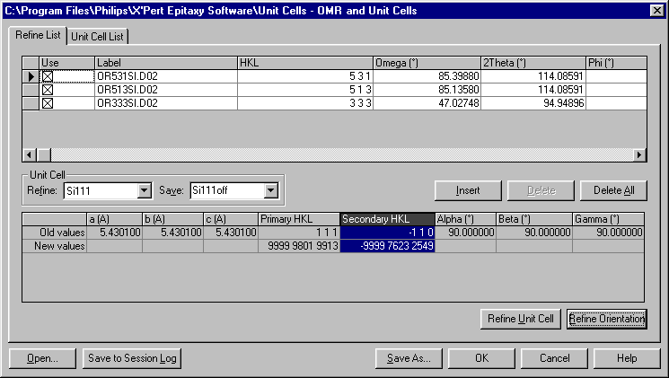
Orientation and Unit Cell Determination
Calculate orientation from positions of measured peaks
Calculate unit cell from position of measured peaks
Uses the same lattice parameter data as the X’Pert Data Collector
Notes:
Orientation matrix refinement enables the calculation of the sample normal direction (orientation refinement) or the sample unit cell parameters (unit cell refinement) from the measured positions of Bragg reflections. The peak positions must be marked.
Orientation matrix refinement requires unit cell data. This data is in two parts:
3 lengths and 3 angles needed to define the unit cell
2 vectors needed to define the sample surface orientation

Slide 34
X’Pert Epitaxy 3.0
Plotting and analysis software
for X’Pert PRO users
interested in sample perfection
Notes:
This presentation shows that X’Pert Epitaxy is a useful tool for analysis of rocking curves, diffraction maps and wafer maps of all kinds of semiconductor materials with diamond, zinc blende and wurtzite structures.

